Slide 1
Classifier-Free Diffusion Guidance
NeurIPS 2021 Workshop
Jonathan Ho, Tim Salimans
Presented by Beomsoon Park
C&I LAB

Slide 2
Contents
Introduction
Background
Guidance
Experiments
C&I LAB

Slide 3
Introduction
C&I LAB

Slide 4
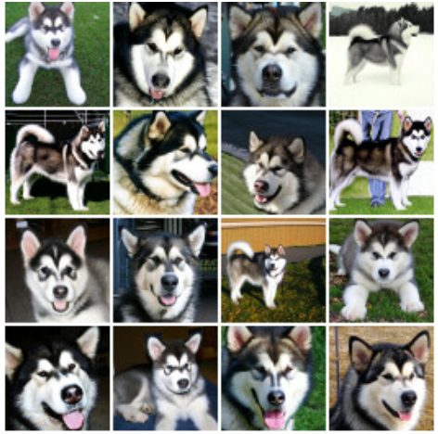
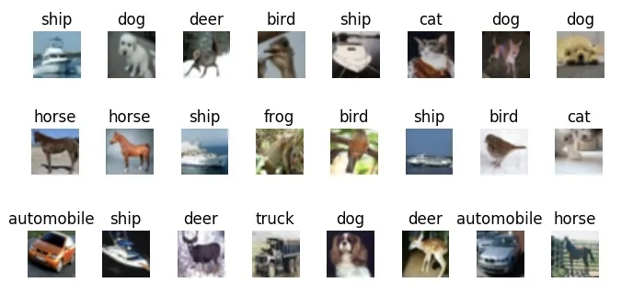
Introduction
Fidelity vs Diversity
Trade-off
Diversity ↓
Sample Quality ↑
Diversity ↑
Sample Quality ↓
C&I LAB

Slide 5
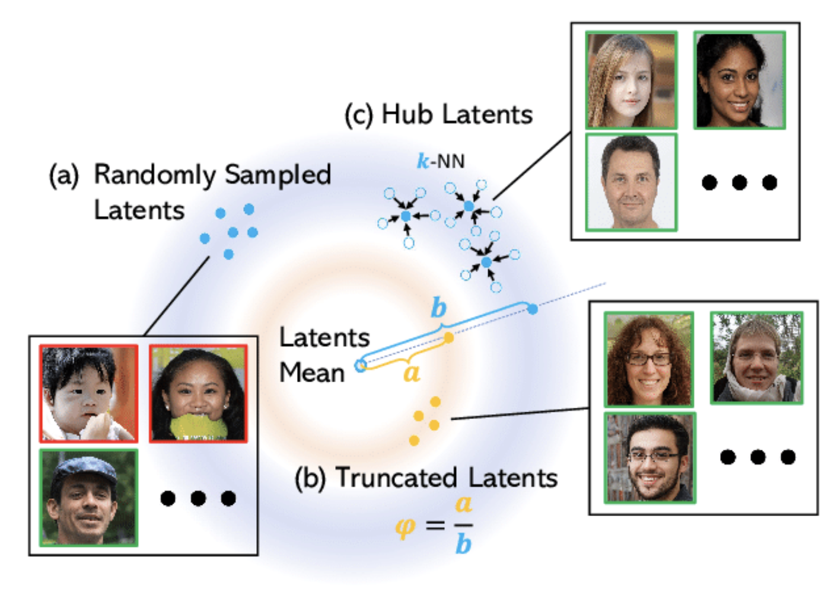
Introduction
Fidelity vs Diversity
Truncation Trick
(GAN)
https://www.researchgate.net/figure/Our-method-vs-random-latent-sampling-and-the-truncation-trick-Marchesi-2017-Brock-et_fig1_361274296
C&I LAB

Slide 6
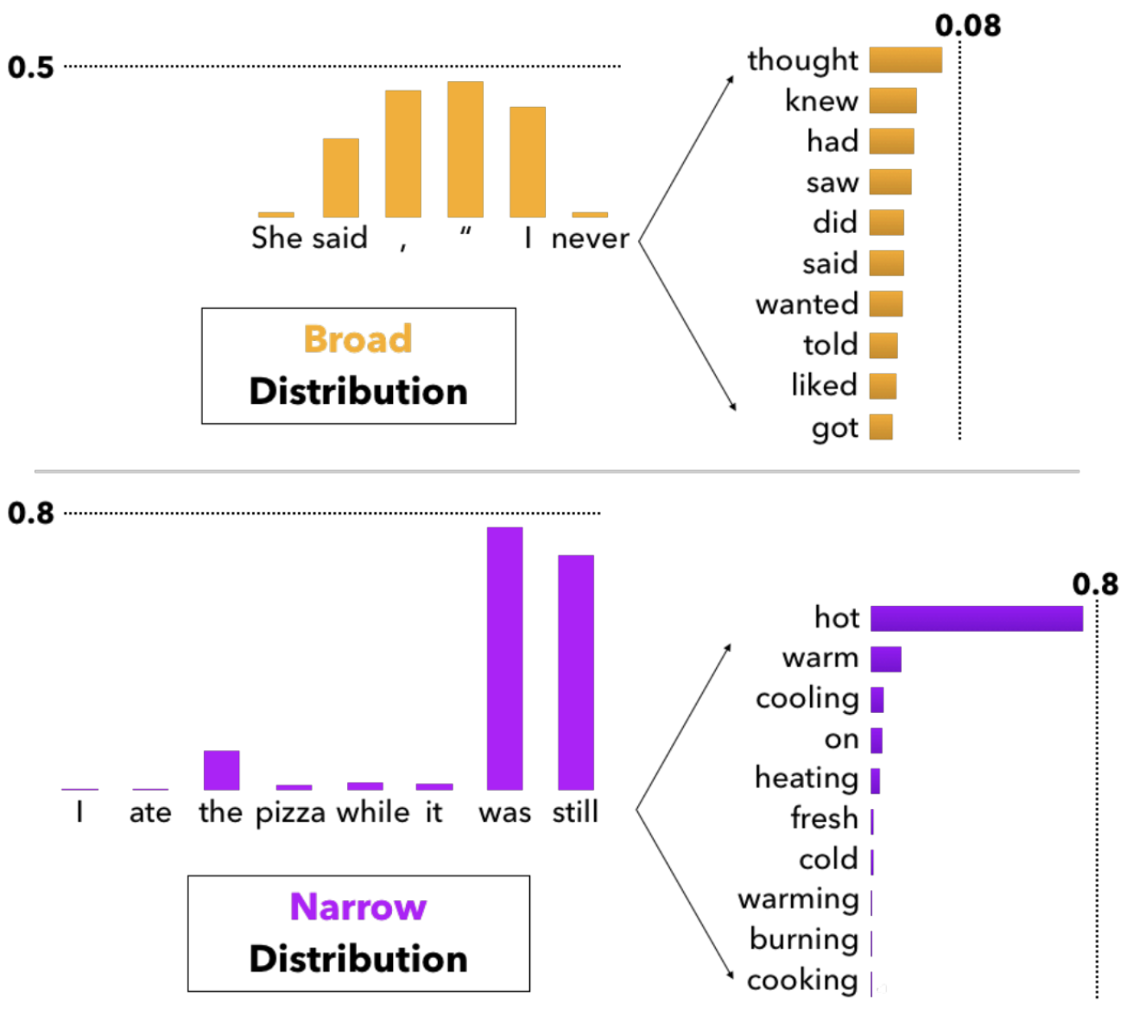
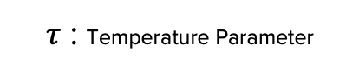
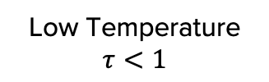
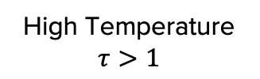
Introduction
Fidelity vs Diversity
High Temperature
$$τ>1$$
Low Temperature
Sampling
Low Temperature
$$τ<1$$
$τ$ : Temperature Parameter
https://towardsdatascience.com/how-to-sample-from-language-models-682bceb97277
C&I LAB

Slide 7
Introduction
Truncation-like effect on Diffusion
Truncation Trick
(GAN)
Low Temperature
Sampling
Not applicable directly to the diffusion models
Classifier-guided
Diffusion Model
C&I LAB

Slide 8
Introduction
Drawbacks of Classifier Guidance
Overhead to train the extra classifier
Complicate Diffusion Model Training Pipeline
Must be trained with noisy data at every training procedure
C&I LAB

Slide 9
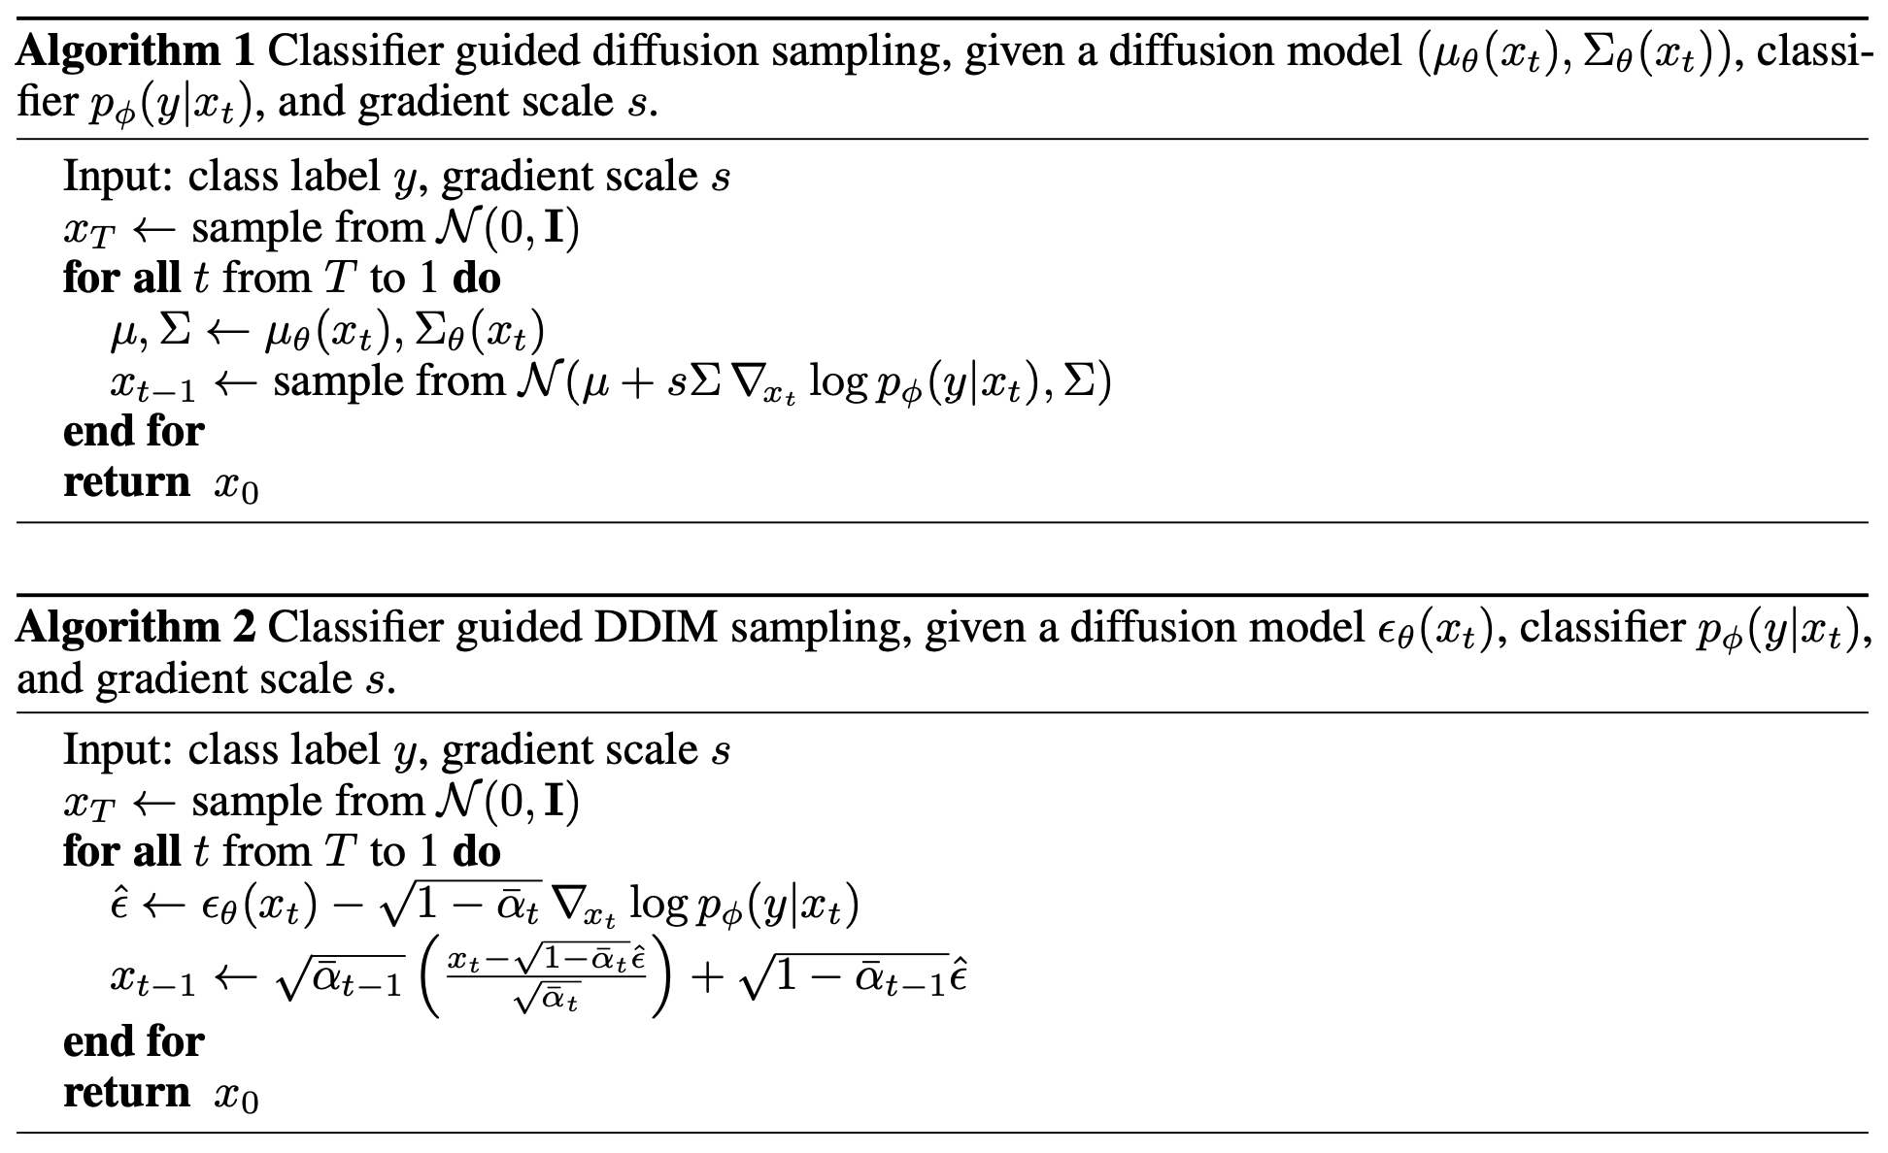
Introduction
Drawbacks of Classifier Guidance
Sampling
→ Mixture of score estimate
& classifier gradient
C&I LAB

Slide 10
Introduction
Drawbacks of Classifier Guidance
Image classifier might be confused as adversarial attack on sampling
Whether this method is eligible for classifier-based metrics is questionable
C&I LAB

Slide 11
Introduction
Classifier-Free Guidance (CFG) Diffusion
Not much overhead for training extra classifier
Extreme Simplicity (Only a change of one line)
Similar FID/IS tradeoff to that of classifier guidance diffusion
C&I LAB

Slide 12
Background
C&I LAB

Slide 13
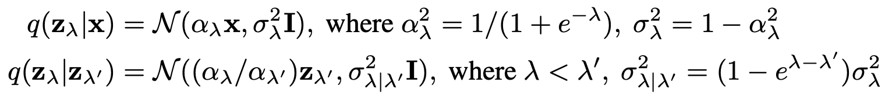
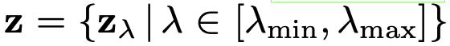
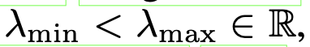
Background
Notation
Forward Process
Noisy Data
Hyperparameter for variance scheduling
C&I LAB

Slide 14
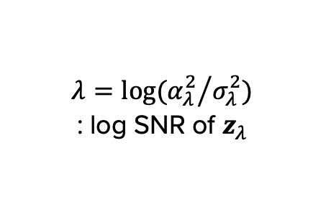
Background
Notation
Forward Process
$$λ=log⁡({α_{λ}^{2}}/{σ_{λ}^{2}})$$
: log SNR of $z_{λ}$
Formularization of forward process feature
C&I LAB

Slide 15
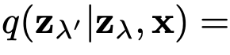
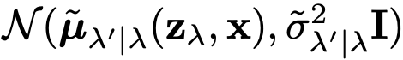
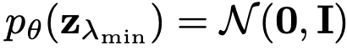
Background
Notation
Forward Process
Final
Sample
Reverse Process
C&I LAB

Slide 16
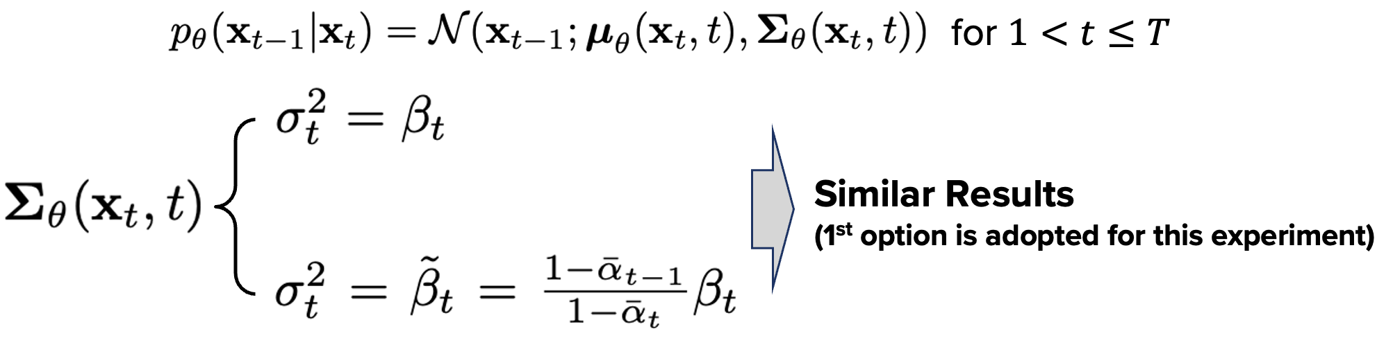
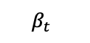
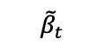
Background
Notation
DDPM
$${\tilde{β}}_{t}$$
$$β_{t}$$
: log-space linear interpolation
$υ$ : constant hyperparameter controlling posterior variance
C&I LAB

Slide 17
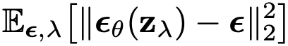
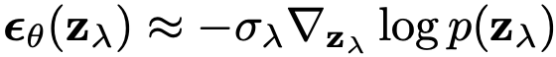
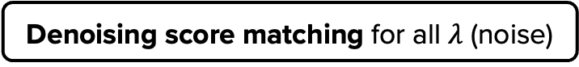
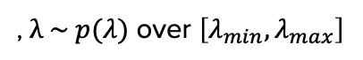
Background
Training Objective
, $λ \sim p(λ)$ over $\left[λ_{min}, λ_{max}\right]$
Denoising score matching for all $λ$ (noise)
With this resemblance…
C&I LAB

Slide 18
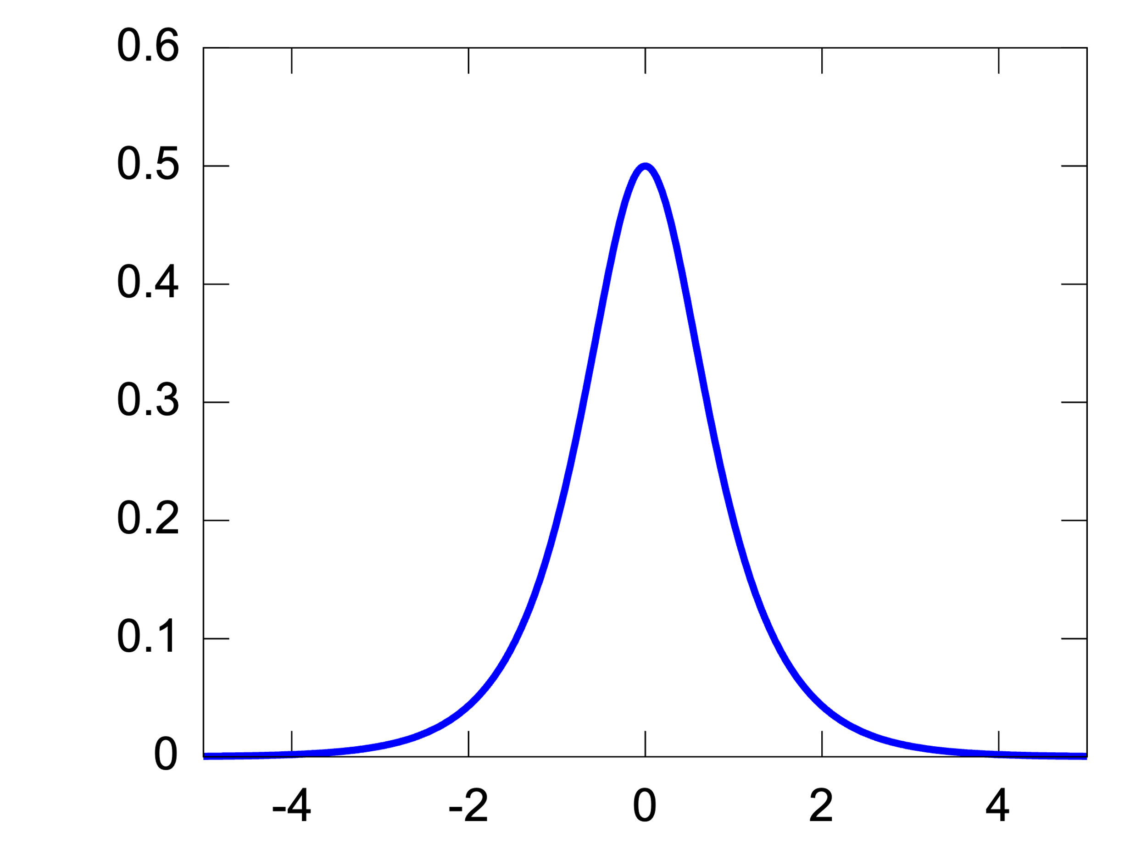
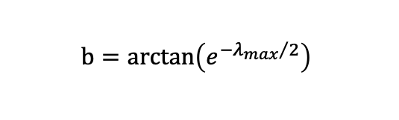
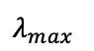
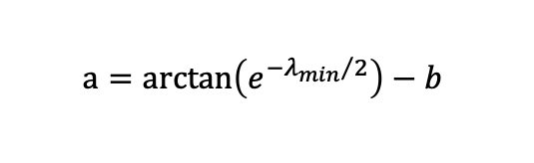
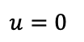
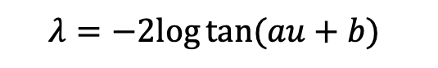
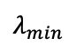
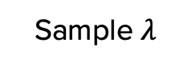

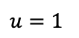
Background
Training Objective
, $λ \sim p(λ)$ over $\left[λ_{min}, λ_{max}\right]$
$$u=0$$
$$u=1$$
$$λ=−2log⁡tan⁡(au+b)$$
$$λ_{max}$$
$$a=\arctan\left(e^{{−λ_{min}}/2}\right)−b$$
$$b=\arctan\left(e^{{−λ_{max}}/2}\right)$$
$$λ_{min}$$
$$u∈[0,1]$$
Sample $λ$
Hyperbolic secant distribution
https://en.wikipedia.org/wiki/Hyperbolic_secant_distribution
C&I LAB

Slide 19
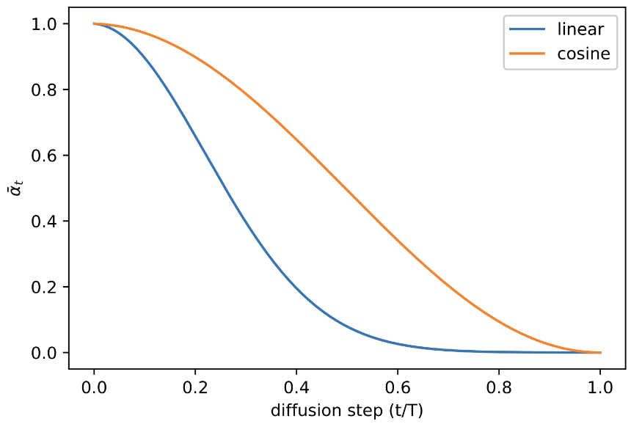
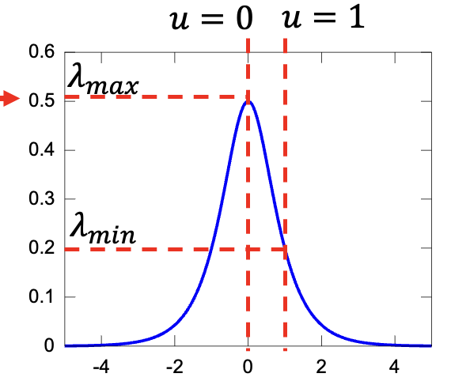
Background
Training Objective
, $λ \sim p(λ)$ over $\left[λ_{min}, λ_{max}\right]$
Weighted variational
lower bound
More sophisticated variance scheduling
→ Improve sample quality
https://en.wikipedia.org/wiki/Hyperbolic_secant_distribution
C&I LAB

Slide 20

Background
Sampling Procedure
Score
Learned noise $≈$ Estimation of $∇_{z_{λ}}log⁡p(z_{λ})$
Correlation between sampling from learned diffusion model
and sampling with Langevin Dynamics
C&I LAB

Slide 21
Guidance
C&I LAB

Slide 22
Guidance
Classifier Guidance
Truncation-like effect in diffusion models
Conditional generative modeling
Conditions have impacts during training and sampling
C&I LAB

Slide 23
Guidance
Classifier Guidance
Parameter determining the strength of classifier
Diffusion Score during conditional generative modeling
classifier
Classifier-guided distribution
(model)
C&I LAB

Slide 24
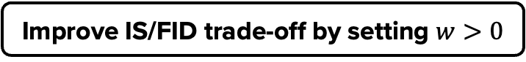
Guidance
Classifier Guidance
Up-weighting the effect of classifier
Higher likelihood to the correct label
Improve IS/FID trade-off by setting $w>0$
C&I LAB

Slide 25

Guidance
Simple Classifier Guidance Experiment
Densities of Mixtures of 3 Gaussians
Non-guided
High guidance strength
C&I LAB

Slide 26
Guidance
Classifier Guidance with unconditional model
Bayes Rule
Same Diffusion score
C&I LAB

Slide 27
Guidance
Classifier Guidance
Better Performance
Conditional Model
Unconditional Model
Classifier-guided conditional model is used for comparison
C&I LAB

Slide 28
Guidance
Classifier-Free Guidance (CFG)
Much simpler implementation
Classifier-guided effect without extra classifier
C&I LAB

Slide 29
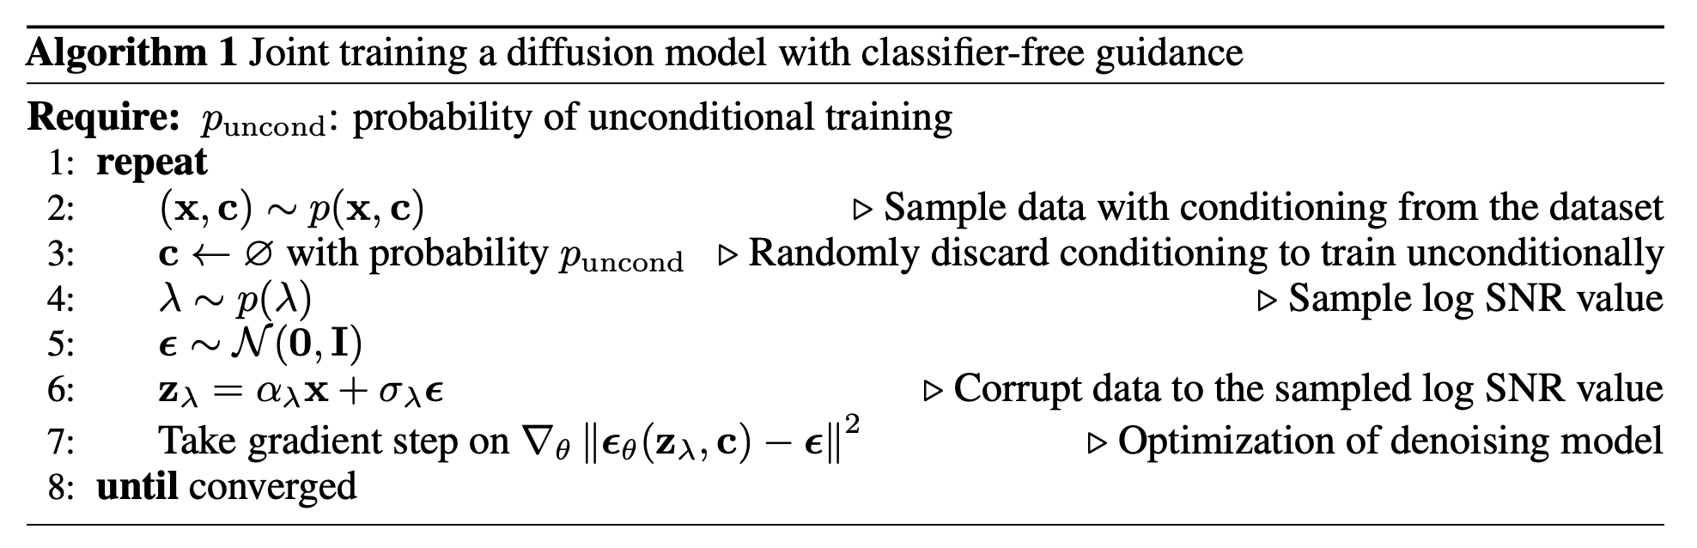
Guidance
Training Classifier-Free Guidance (CFG) diffusion model
Similar training process to that of DDPM
C&I LAB

Slide 30
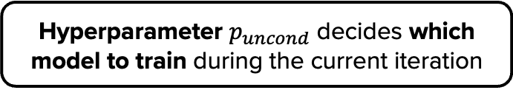
Guidance
Training Classifier-Free Guidance (CFG) diffusion model
Unconditional model & Conditional model
is being trained with 1 neural network
Hyperparameter $p_{uncond}$ decides which model to train during the current iteration
C&I LAB

Slide 31
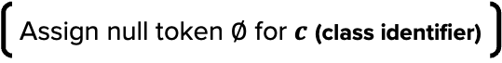
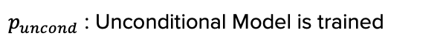
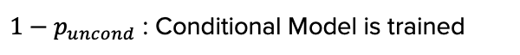
Guidance
Training Classifier-Free Guidance (CFG) diffusion model
$1−p_{uncond}$ : Conditional Model is trained
Assign null token $∅$ for $c$ (class identifier)
$p_{uncond}$ : Unconditional Model is trained
C&I LAB

Slide 32
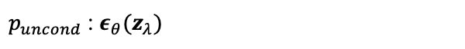
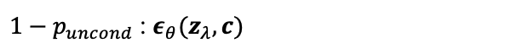
Guidance
Training Classifier-Free Guidance (CFG) diffusion model
$1−p_{uncond}$ : $ε_{θ}(z_{λ},c)$
$p_{uncond}$ : $ε_{θ}(z_{λ})$
C&I LAB

Slide 33
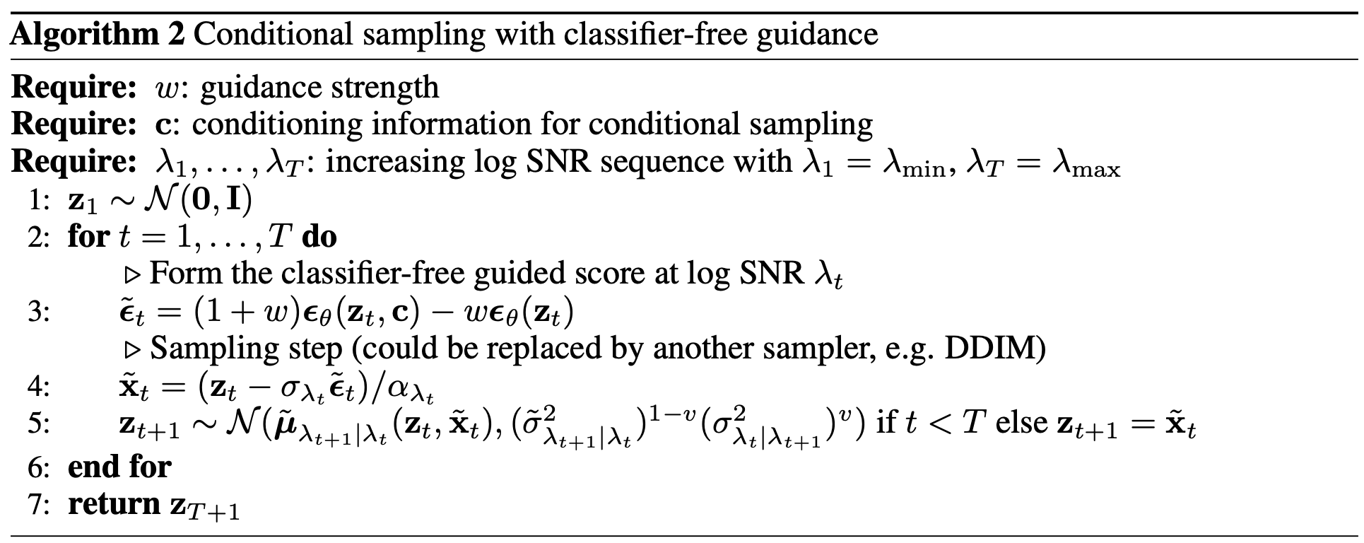
Guidance
Sampling from Classifier-Free Guidance (CFG) diffusion model
Conditions utilized during training
Sampling Order
Main point
Also resemble
DDPM sampling
procedure
C&I LAB

Slide 34
Guidance
Suggested score from Classifier-Free Guidance
${\tilde{ε}}_{θ}\left(z_{λ},c\right)=w\left(ε_{θ}\left(z_{λ},c\right)−ε_{θ}\left(z_{λ}\right)\right)+$ $ε_{θ}\left(z_{λ},c\right)$
Implicit classifier guidance
Parameter determines the strength
C&I LAB

Slide 35
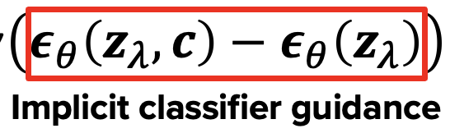
Guidance
Classifier-guided Effect
Recap – Classifier-guided Score
Score
(Conditional generative model)
Score
(Classifier)
C&I LAB

Slide 36

Guidance
Classifier-guided Effect
Just estimation, not actual classifier gradient
${\tilde{ε}}_{θ}\left(z_{λ},c\right)=w\left(ε_{θ}\left(z_{λ},c\right)−ε_{θ}\left(z_{λ}\right)\right)+$ $ε_{θ}\left(z_{λ},c\right)$
Classifier Guidance
Score
(Conditional generative model)
Score
(Classifier)
C&I LAB

Slide 37
Experiments
C&I LAB

Slide 38
Experiments
Experiment
Main Purpose
Demonstrating attaining IS/FID trade-off similar to that of classifier guidance
Same model architecture & hyperparameter settings from classifier guidance
Suboptimal for classifier-free guidance diffusion model
C&I LAB

Slide 39

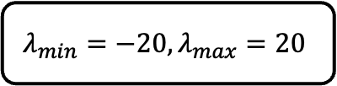

Experiments
Experiment Settings
IS/FID score calculation
with 50K Samples
$$λ_{min}=−20, λ_{max}=20$$
64 X 64
Conditional ImageNet
Model
Sampler noise interpolation coefficient $v=0.3$, 400K Training steps
128 X 128
Conditional ImageNet
Model
Sampler noise interpolation coefficient $v=0.2$, 2.7M Training steps
C&I LAB

Slide 40
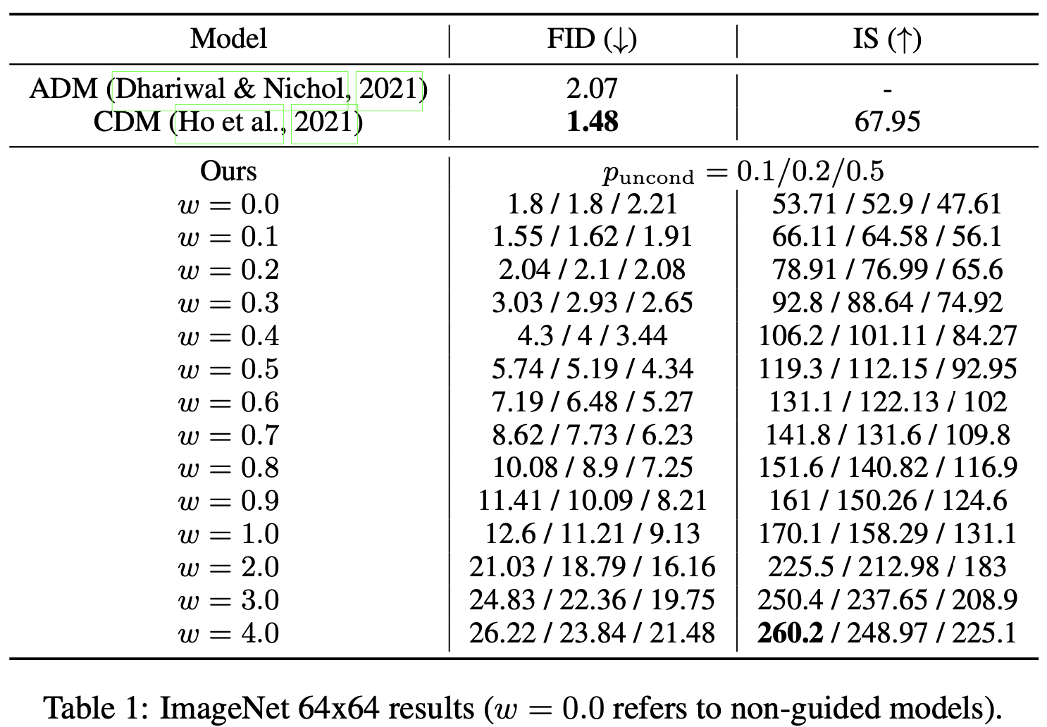
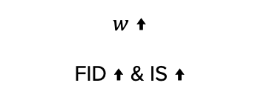
Experiments
Varying Classifier-Free Guidance Strength
$w$ ↑
FID ↑ & IS ↑
C&I LAB

Slide 41
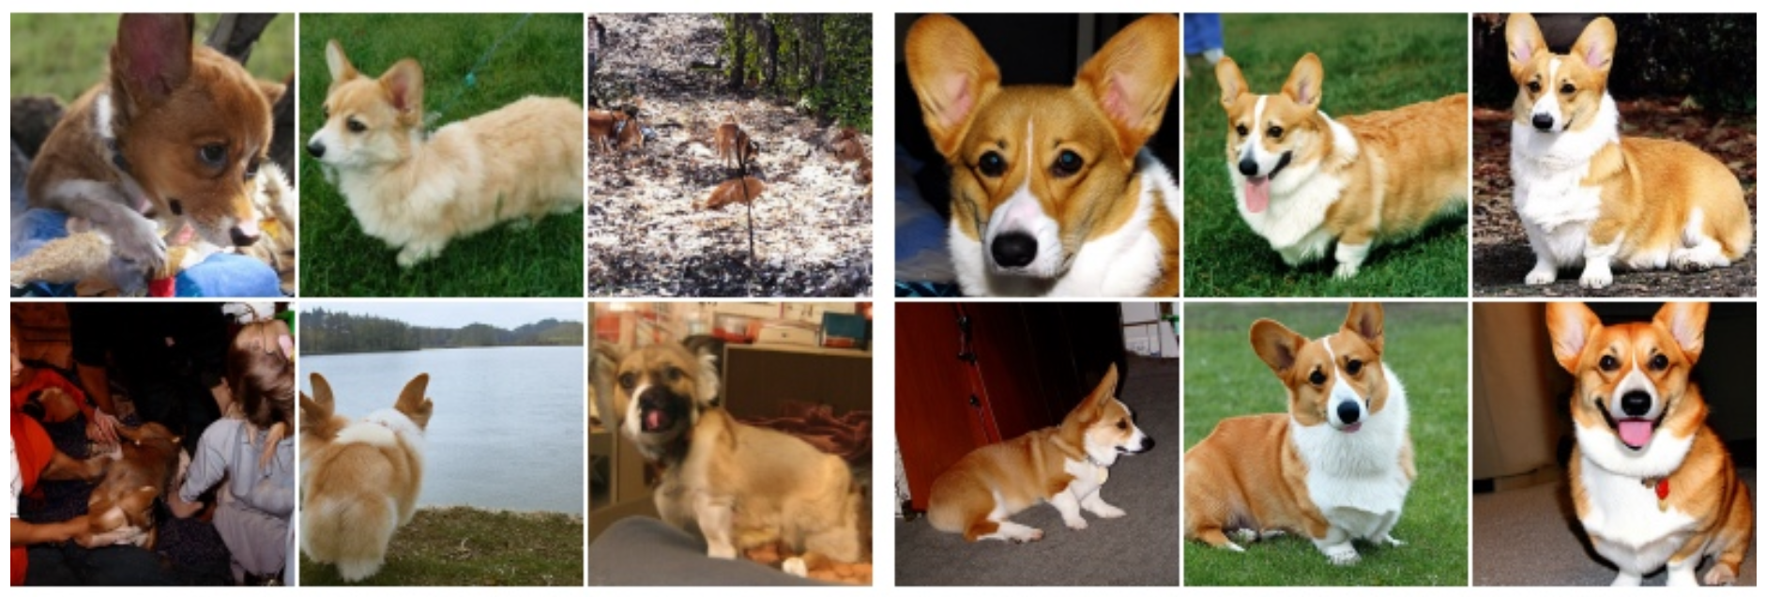

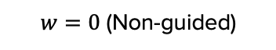
Experiments
Varying Classifier-Free Guidance Strength
$w=0$ (Non-guided)
$$w=3.0$$
C&I LAB

Slide 42
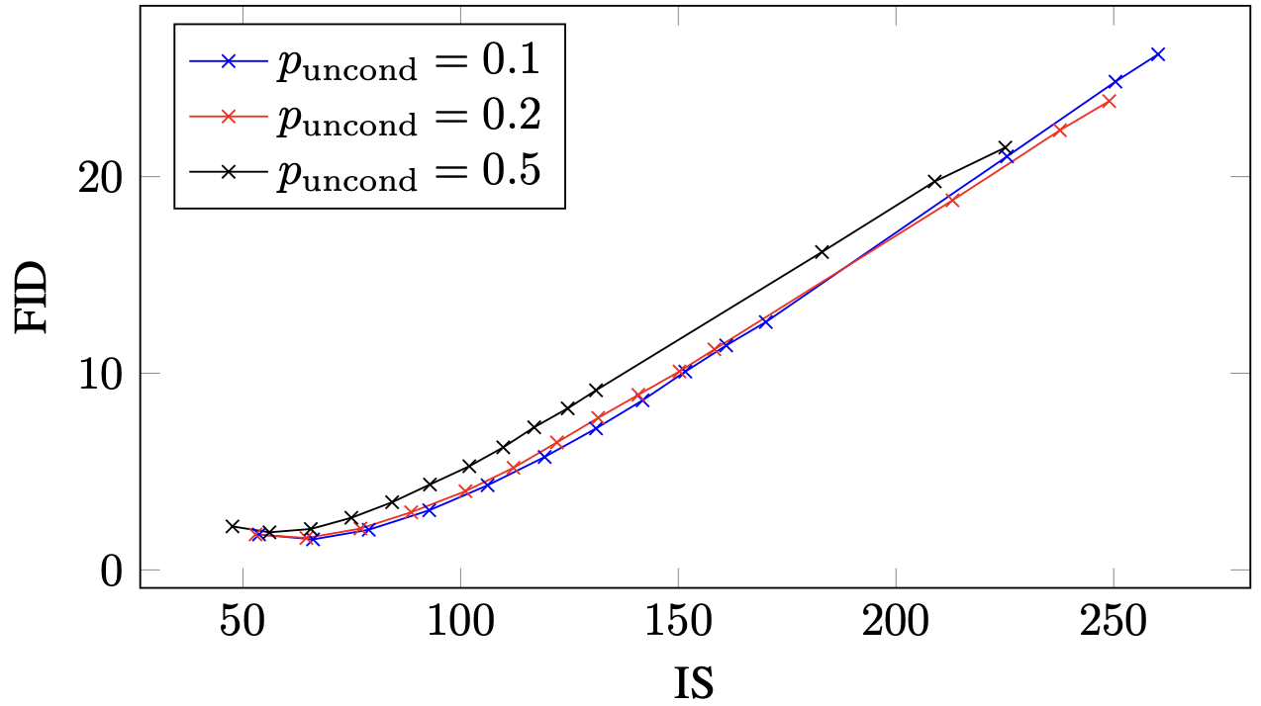
Experiments
Varying Unconditional Training Probability
(Small portion for unconditional model)
Best Performance
C&I LAB

Slide 43
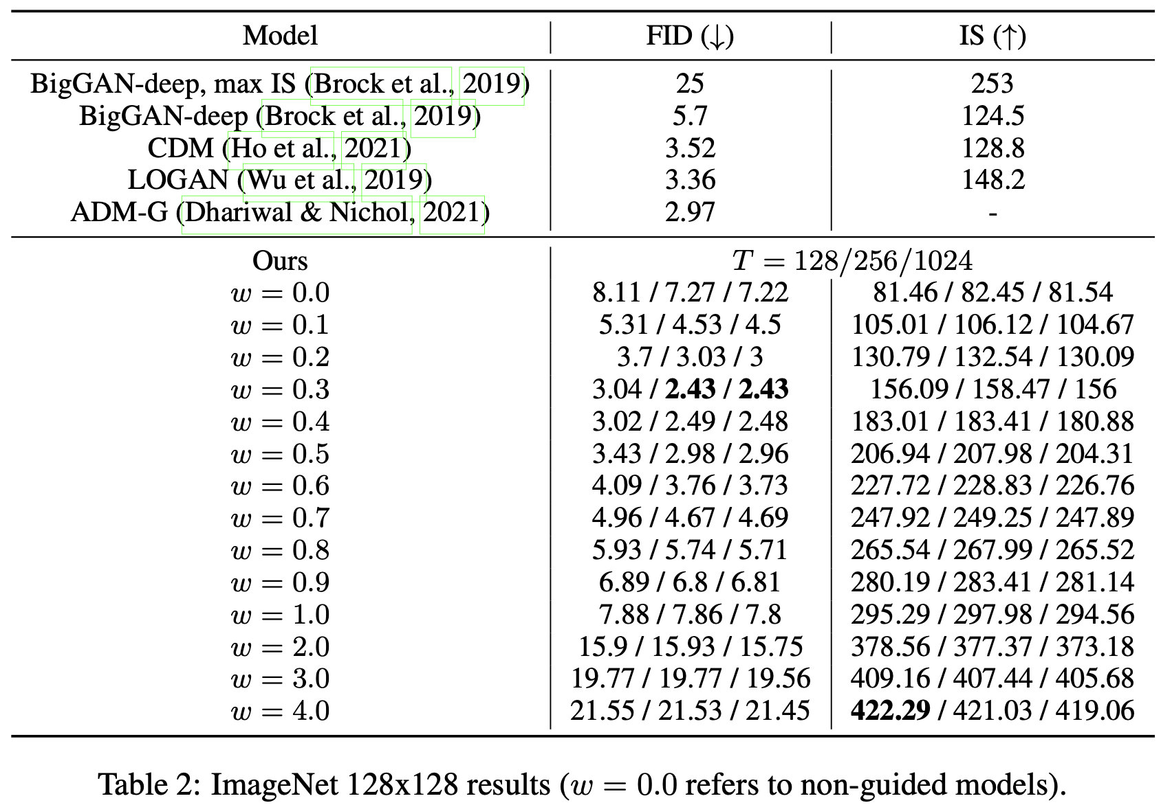

Experiments
Varying Sampling Steps
C&I LAB

Slide 44

Experiments
Varying Sampling Steps
Classifier-Guidance Diffusion
$$T=256$$
Best balance
between sample quality & sampling speed
CFG Diffusion model should go through 2 times of forward process
(Conditional & Unconditional Model Training)
Leading to Slow Sampling Speed
C&I LAB

Slide 45
Thank you
C&I LAB

